Slide 1
Getting started with new hardware and QMP
Fernando Gros González
25-02-2013

Slide 2
Table of contents
Introduction
Hardware components
First Mesh
Following steps
Future tasks

Slide 3


Introduction
These days I have been working with the new hardware and the firmware (qmp), trying to flash the devices and getting them work together.

Slide 4
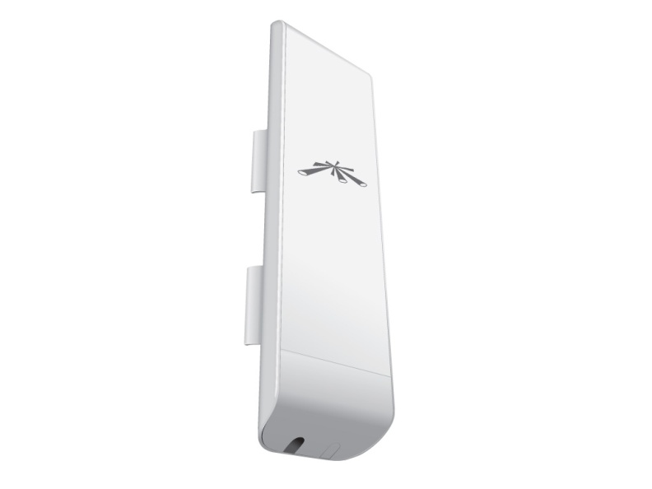
Hardware components (I)
These are the devices I have started to work with:
Nanostation M5:
Description: CPE device (Customer Premises Equipment) outdoor which transmits on the 5GHz band.
Details:
Protocols: 802.11a, 802.11n
Outside reach: more than15km
Transmission frequency: 4900-5800MHz
Max. Transmitted power: 27 dBm
Bandwidth: Until 150Mbps

Slide 5
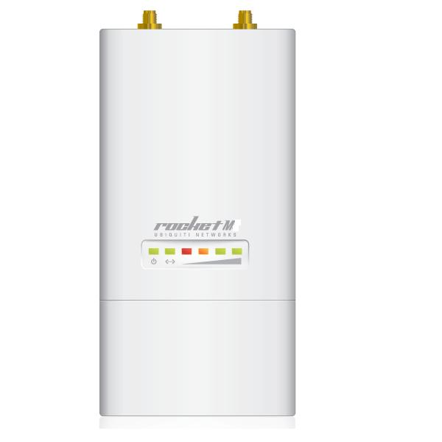
Hardware components (II)
Rocket M5:
Description: Outdoor base station which transmits in the 5GHz band
Details:
Protocols: 802.11a, 802.11n
Outside reach: more than 50km (depending on the antenna)
Transmission frequency: 4900-5800MHz
Max. Transmitted power: 27 dBm

Slide 6
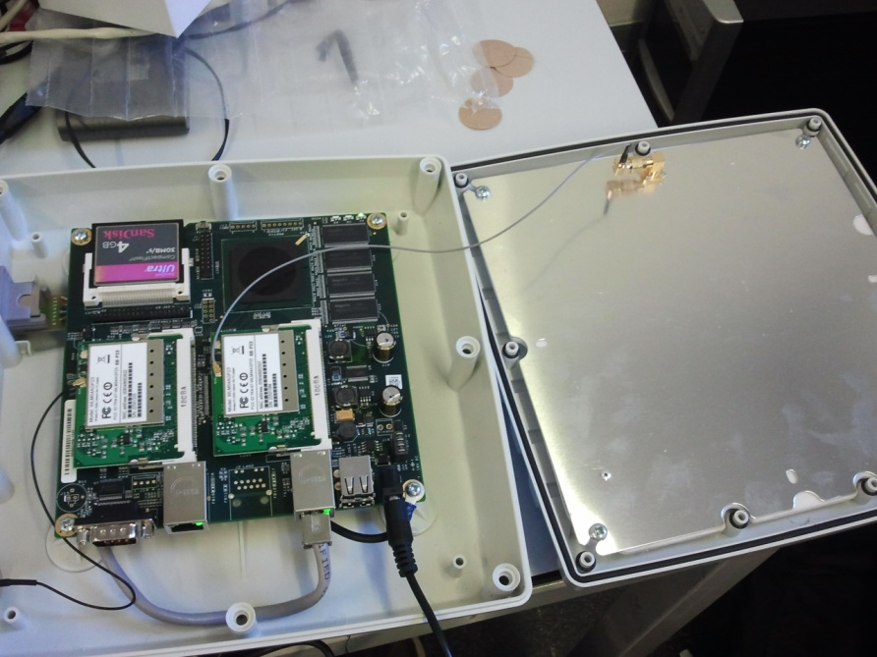
Hardware components (III)
Alix 2d2:
Description: Low power motherboard
Details:
Protocols: 802.11a/b/g (2 radios)
Transmission frequency: 4900-5800MHz
Max. gain: 20 dBi

Slide 7
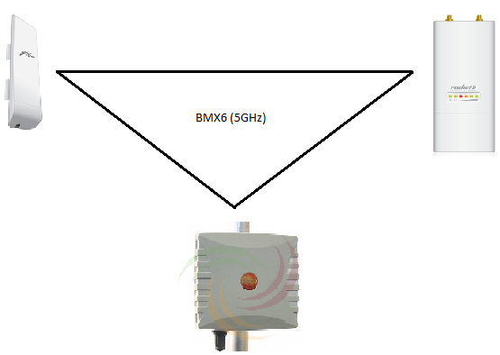
First Mesh
I have flashed the three main components with qmp and they automatically build a mesh among them.

Slide 8
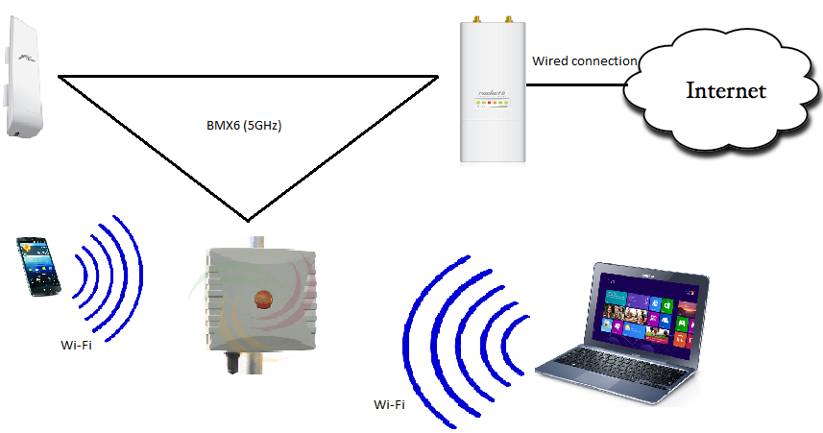
Following steps
Now that the mesh network seems to work correctly, the next step will consist on connect one of the existing nodes to a wider network (Internet) and try to allow other devices to connect to the Mesh and get access to this wider network.

Slide 9
Future tasks
The main task for the future is to transform the alix node into a node which can be mobile and can fit in an existing infrastructure (qmp-based obviously).
Another task is developing a system that allow users with a smartphone to stream video directly to the Internet using the Mesh infrastructure (this can be a difficult task and I will have to consider in the near future if it fits in the scope of my TFG or not)

Slide 10
Thank you for your time!

